Slide 1
#01 Class, Abstract Class and Interfaces
Notes:
Give an explanation for the concepts class, abstract class and interface
Relevant theoretical decisions
What are classes and objects and what is special for these concepts?
What are visibility modifiers and how are they used in a program?
What is an interface and what is it used for?
What is an abstract class, when and how is it used?
What is garbage collection and what is the purpose for that?

Slide 2
Class
What is a class?
Syntax: [attributes] [access-modifiers] class identifier [:[base-class [,interface(s)]]
{class-body}
Creating Objects
Objects are defined by a class
Notes:
Concept: Class is the blueprint from which an object i created.
attributes: C# provides a mechanism for defining declarative tags, called attributes, which you can place on certain entities in your source code to specify additional information. The information can be retrieved at run-time. [Serializable] is an attribute used when working with objects and files.
Access-modifiers: public, private, protected, internal and protected internal. private is the default modifier.
Base-class is the class that this newly declared class inherit from.
A C# interface is a collection of abstract methods and constants, that is they are not implemented just declared. When a class implements an interface, at guarantees all its clients that it support all the methods, properties etc…. Of the named interface.
Object has a state(currentBalance in an account object) and a set of behaviors(activities associated with the object(withdrawal & deposit in an account object)).
Example: Console.Out.WriteLine, WriteLine is a method provided by the Console.Out object, where .Out is an object variable that is stored in the Console class.

Slide 3
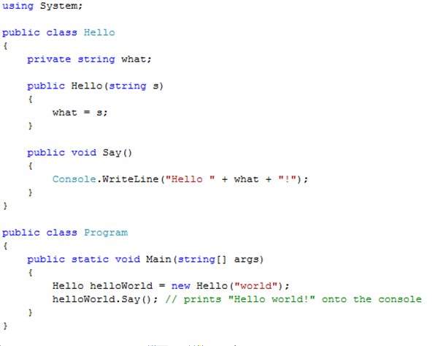
Class Example and Visibility

Slide 4

Interfaces
“An interface is a contract that guarantees to a client how a class will behave”
A Class can implement more the one interface
Interfaces can be extended and combined
Syntax: [attributes] [access-modifier] interface interface-name[:base-list]
{interface-body}
Notes:
When a class implements an interface, it tells any potential client “I guarantee I’ll
support all the methods, properties, events, and indexers of the named interface.”
A class that implements an interface MUST! implement all the interface defined methods, properties, indexers and events.

Slide 5
Abstract Class
Generic concept in class hierarchy
Cannot be instantiated
Usually contains som abstract methods
Class is declared by including the abstract modifier in the class header
Used to declare variables that is generic in all the children of the class
Abstract methods used in the children must be defined in by each child
Classes that are derived from an abstract parent must override all of the parents methods.
Notes:
It represents a concept upon which other classes can build their definitions.
Abstact methods are also used to define C# interface. Unlike interfaces an abstract class can contain methods that are not abstract it also can contain data declarations other than constants.
Any class that contains abstract methods (unlike interfaces) must be declared as abstract.
May contain a partial description that is inherited by all its descendants.
The children must override all the parents abstract methods or the derived class will also be considered abstract.
There are no restrictions where a abstract class is defined in the class hierarchy but usually they are locatede at the upper levels.
An abstract method shouldn’t be modified as static because a static method can be invoked using the class name without declaring an object of the class. This is a contradiction because abstract methods have no implementation.
By using abstract classes wisely, code can be created flexible and is important in extensible software designs.

Slide 6
Abstract class example
abstract public class Control
{
protected int top;
protected int left;
// constructor takes two integers to
// fix location on the console
protected Control(int top, int left)
{
this.top = top;
this.left = left;
}
abstract public void DrawWindow( );
}

Slide 7
Abstract Class Vs Interface
Interfaces are very smiliar to abstract classes
Interfaces are used instead of abstract classes because C# doesn’t allow inheritance from multiple classes

Slide 8
Garbage Collector
C# performs automatic garbage collection
Collection/removing objects that are marked as garbage
Object that no longer has a reference
C# programmers don’t need to worry about explicitly reclaiming memory that has become garbage
Notes:
Objects on the heap are automatically destroyed some time after the final reference to them is destroyed.
The destructor is called by the garbage collector when the your object is destroyed.
You can’t call an object’s destructor directly. The garbage collector will call it for you.
Garbage collector has a list of all objects that have a destructor. This list is updated everytime a an object are created and detroyed.
When an object on this list is first collected, it is placed in a queue with other objects
waiting to be destroyed. After the destructor executes, the garbage collector collects
the object and updates the queue, as well as its list of destructible objects.
A destructor must be declared for an object that controls unmanaged resources to explicitly free those.

Slide 9
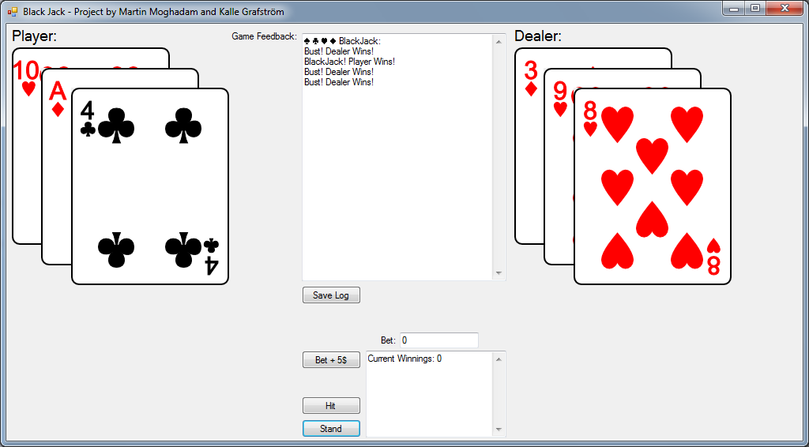
Use in our program
Black Jack Game
Log
Save Log
Betting
Hit
Stand

Slide 10
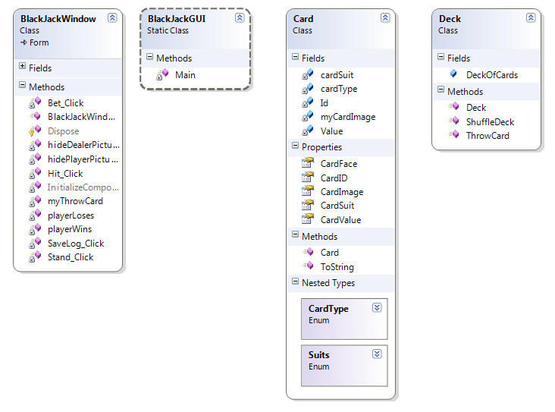
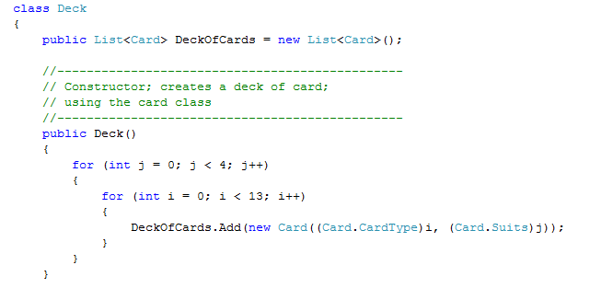
Use in our program
List and foreach in our application
Notes:
Our application uses list to contain the cards and the foreach statement to manage the cards
Our application contains a simple card class, and a deck class.
A deck of cards is a list that contains objects of the type card.

